Slide 1
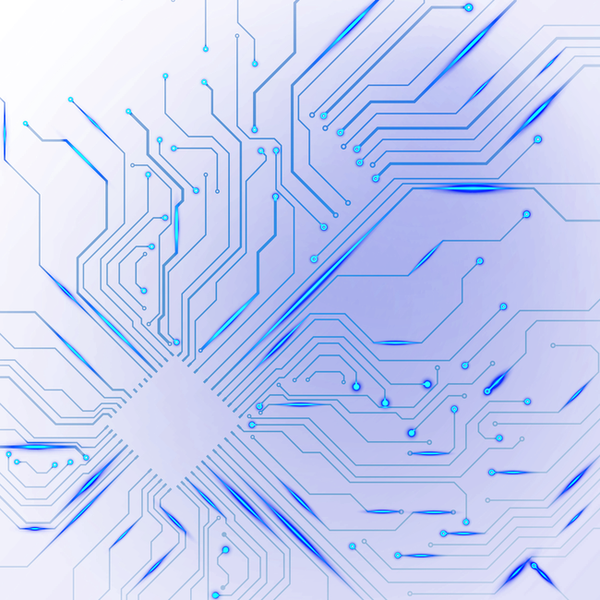


Prediction of Grasp Positions for Cubic Objects in Images
This presentation will introduce our Computer Vision project, highlighting its objectives, methodologies, and potential impact.
https://github.com/Agness2049/Computer_Vision_Project-Chiessi_Moscato-.git
by
Agnese Chiessi and Ludovica Moscato

Slide 2
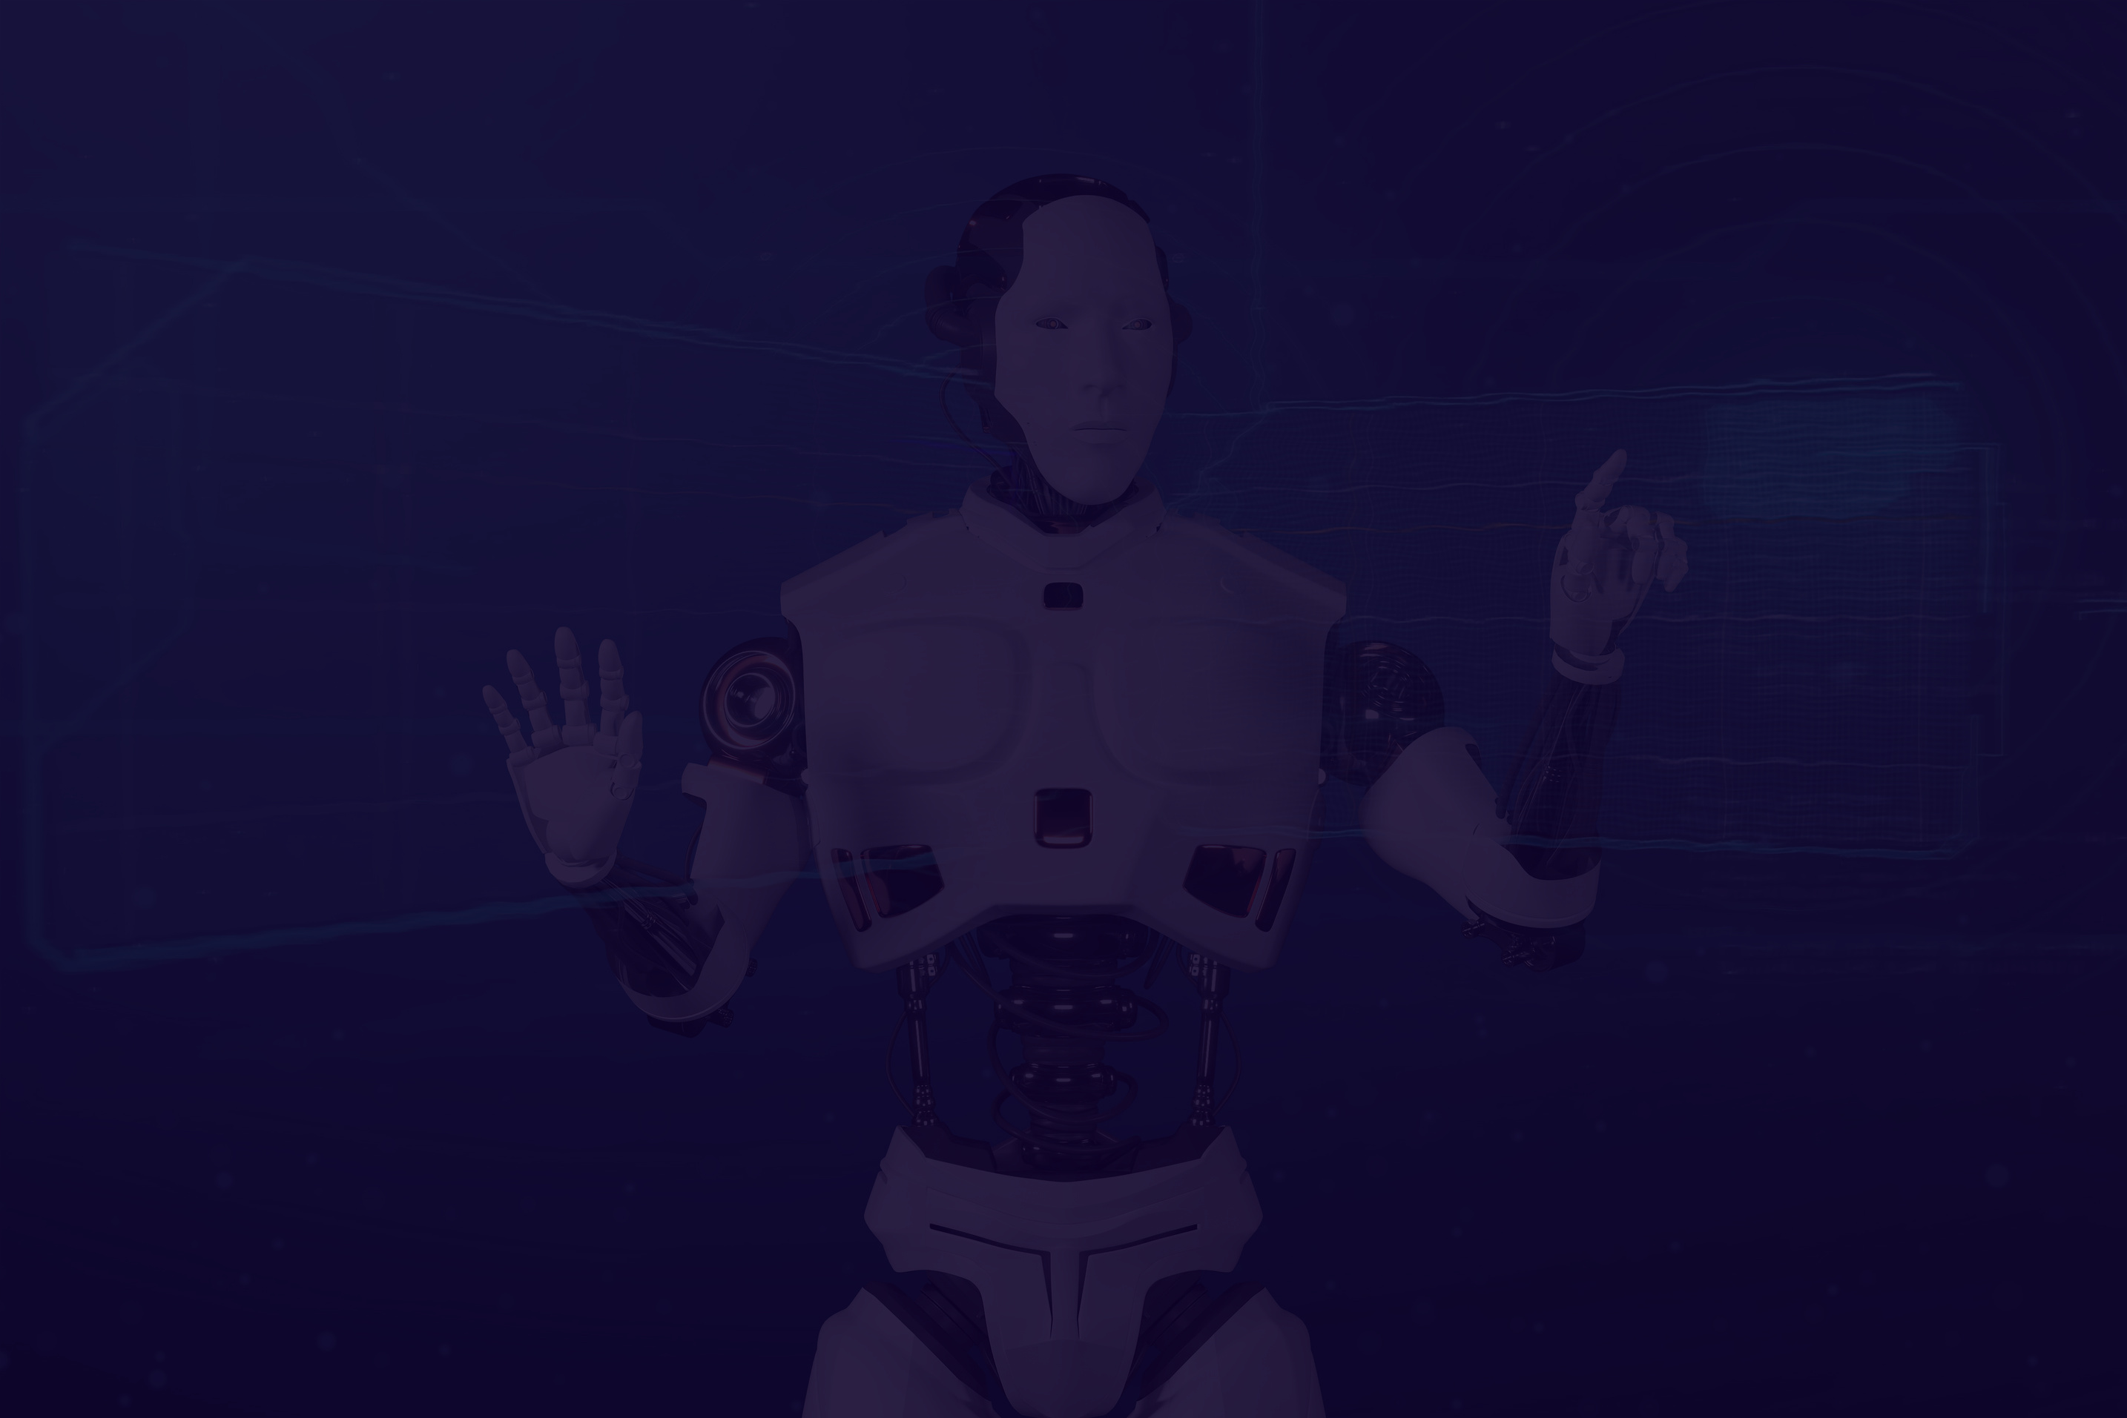
02
Project Overview
The project aims to generate correct grasp positions for cubic objects.
Key steps include:
dataset creation and transformation,
model development,
classification of grasp positions on new images

Slide 3
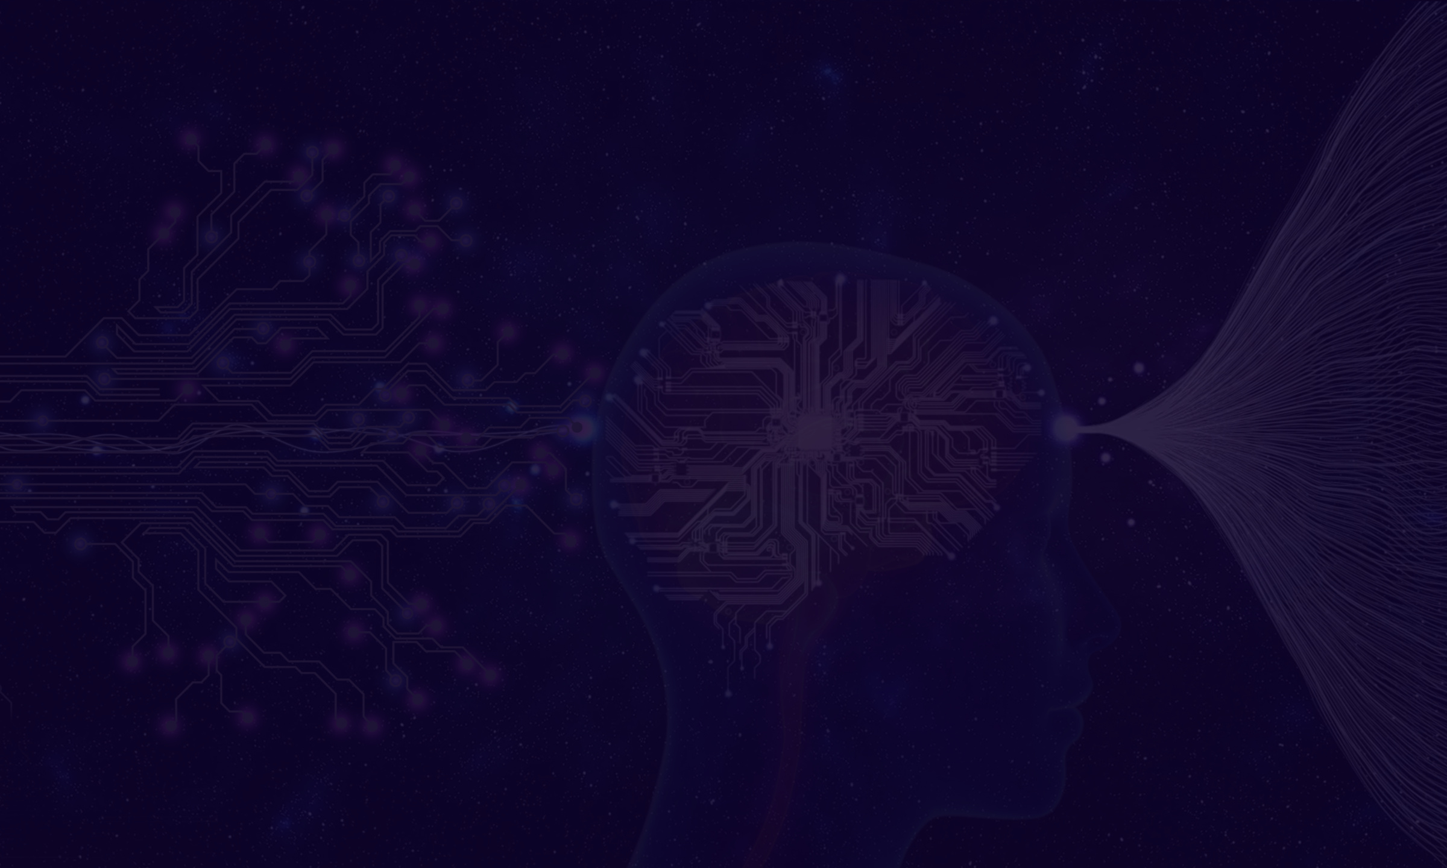

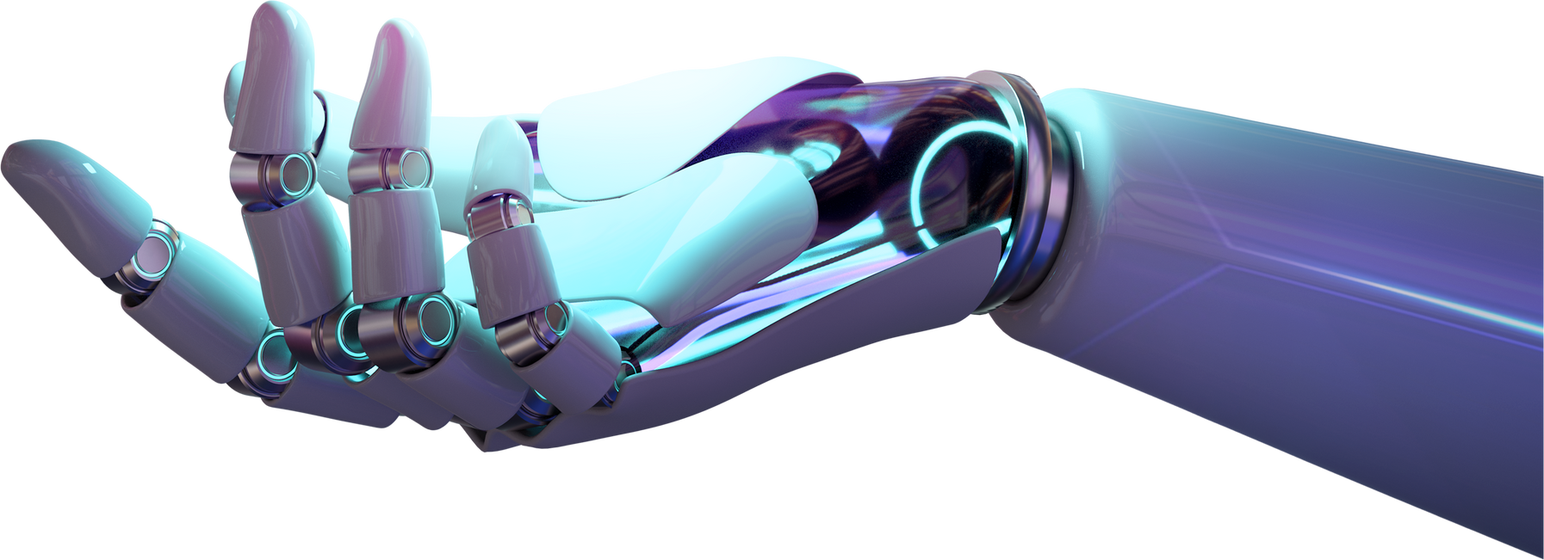
Motivation
Grasping is crucial in robotics, particularly in industrial settings, where precise and efficient grasping improves tasks such as assembly, manufacturing, and sorting.
03

Slide 4

Problems
Acquiring the dataset;
Understanding the characteristics needed to identify a correct grasp position;
Selecting the appropriate model;
Addressing overfitting;
Insufficient RAM.
04

Slide 5

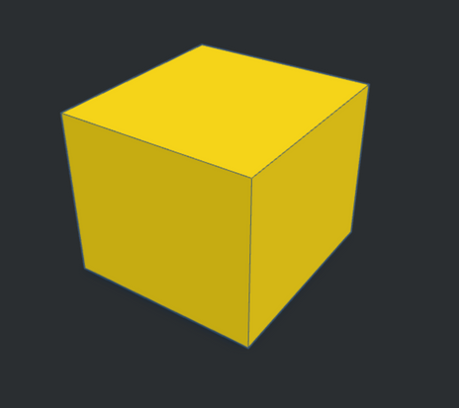
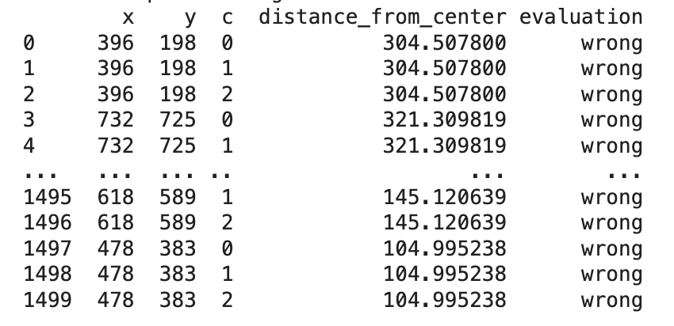
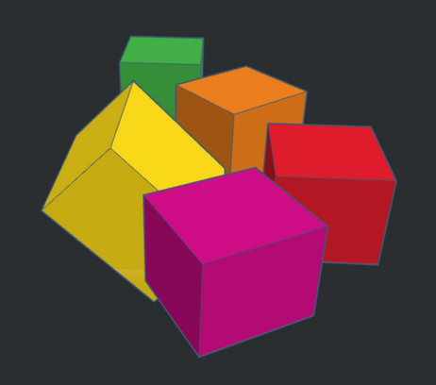
05
Dataset creation
Image loading
Evaluation table
Data augmentation
Cube creation
Cube loading
Mask
Grasp position generation
Label assignment
Transformations

Slide 6
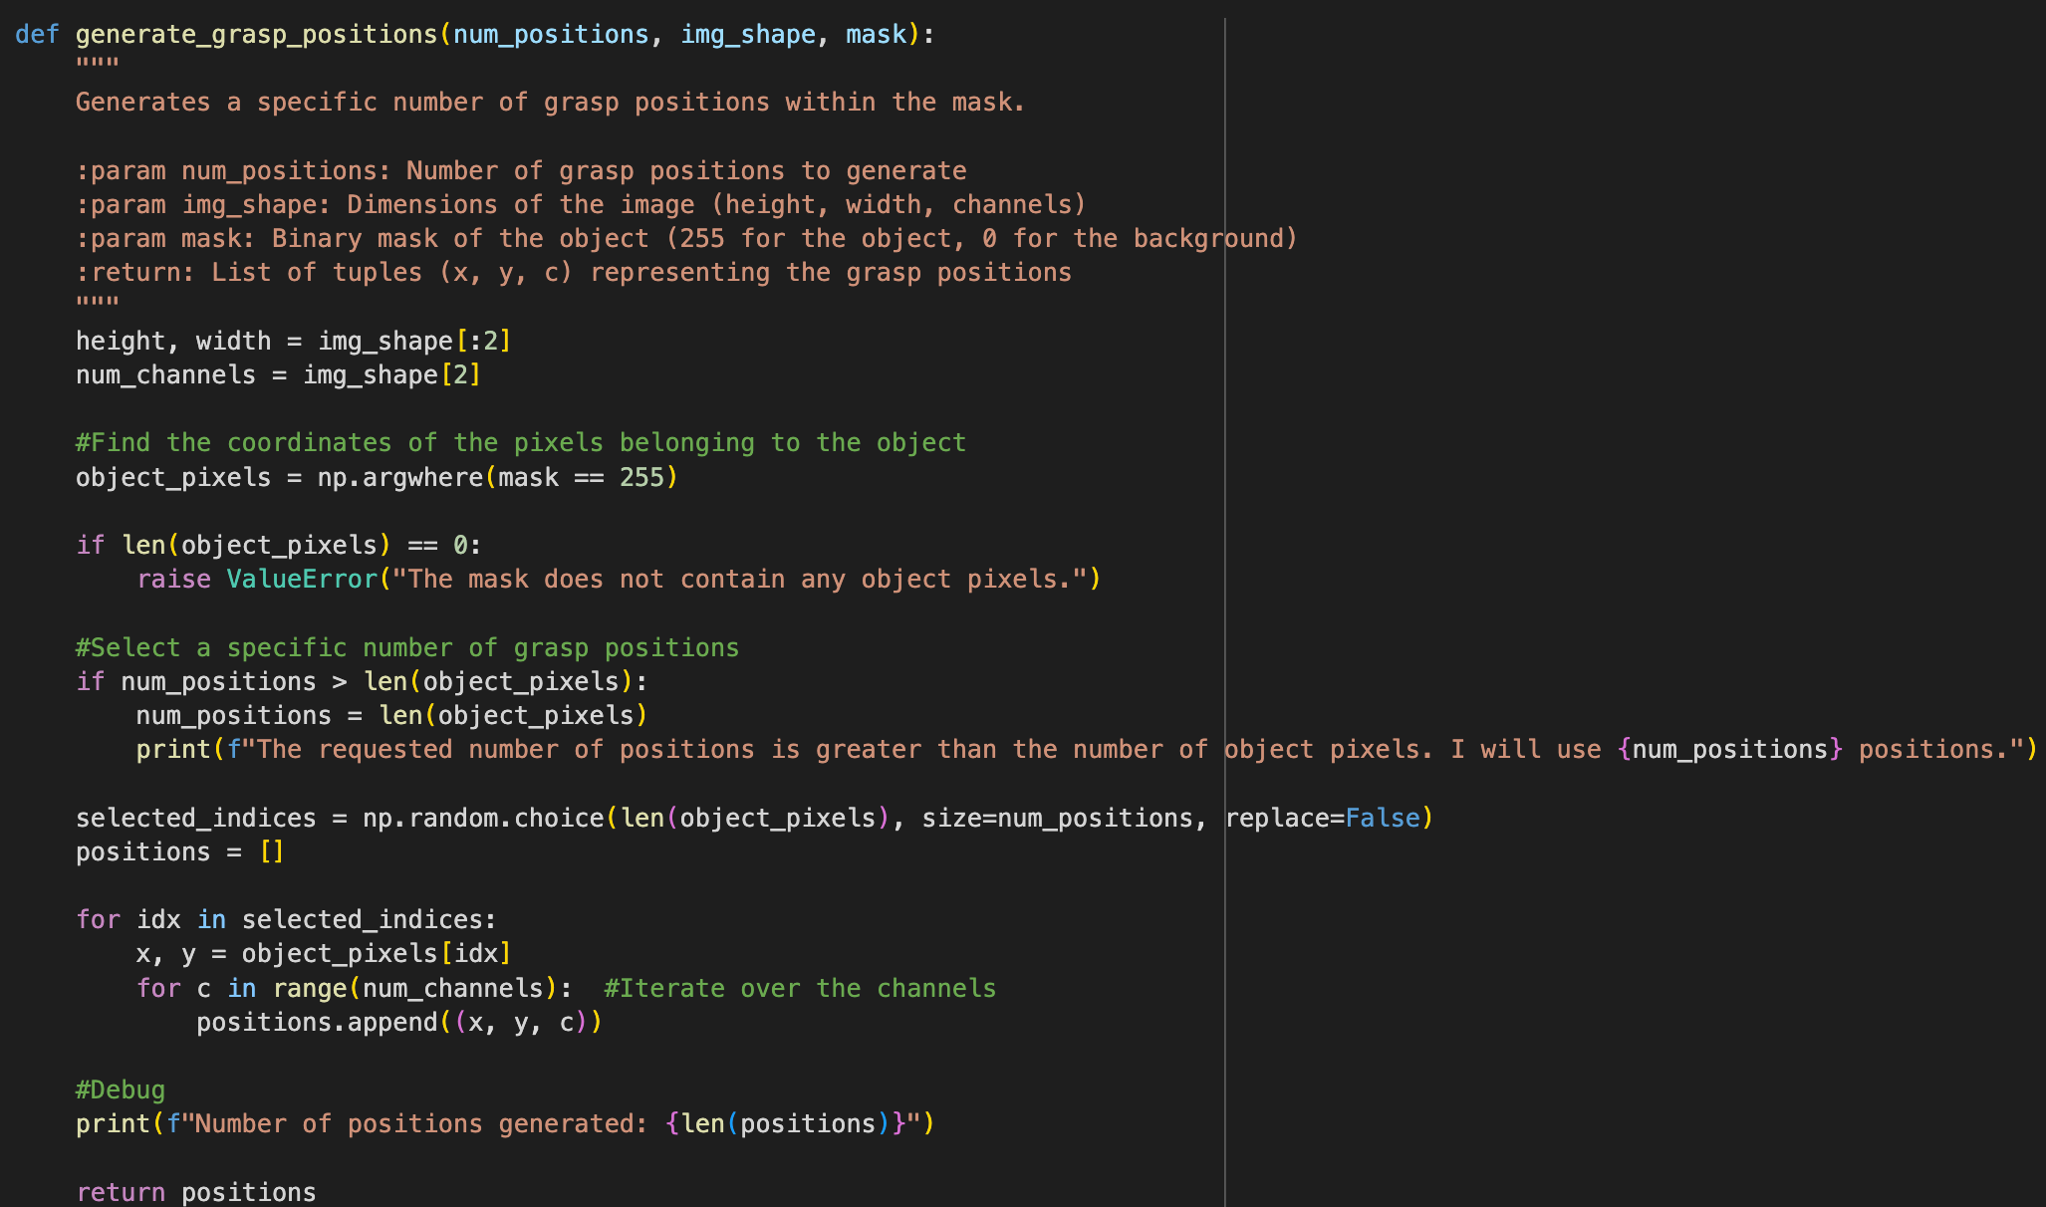
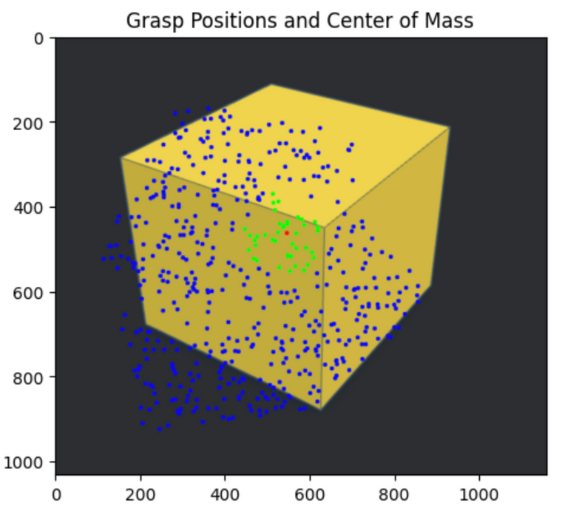
Grasp position generation

Slide 7

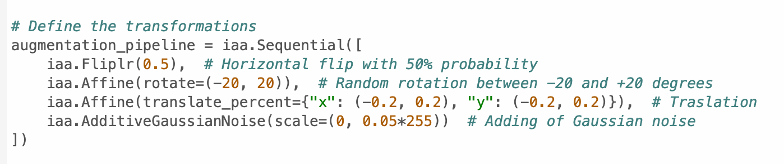
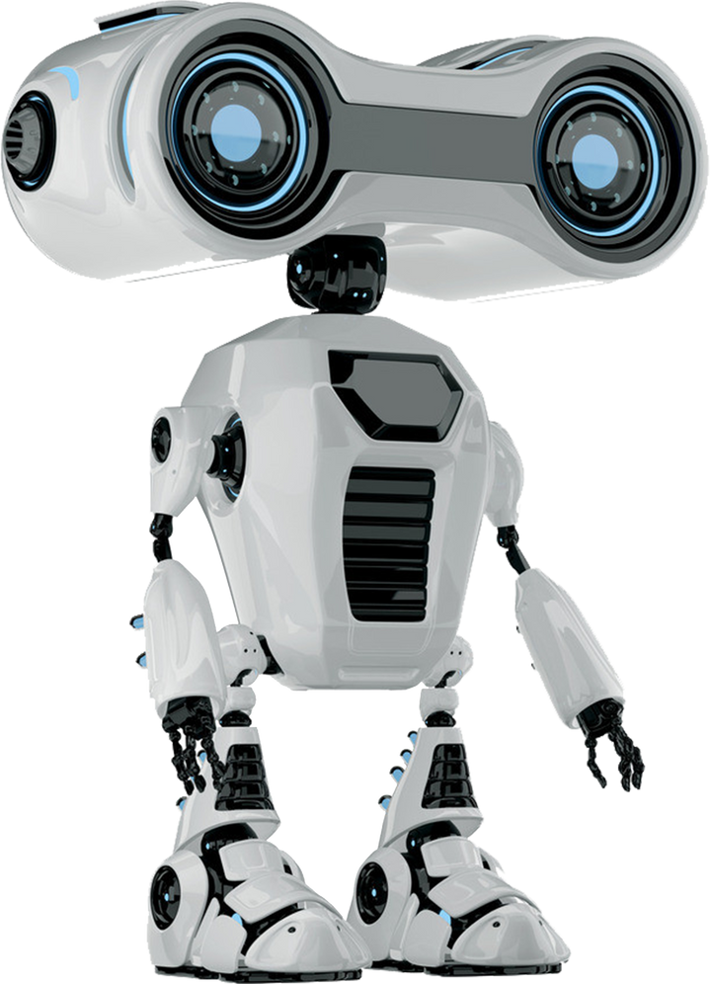
07
Data augmentation

Slide 8


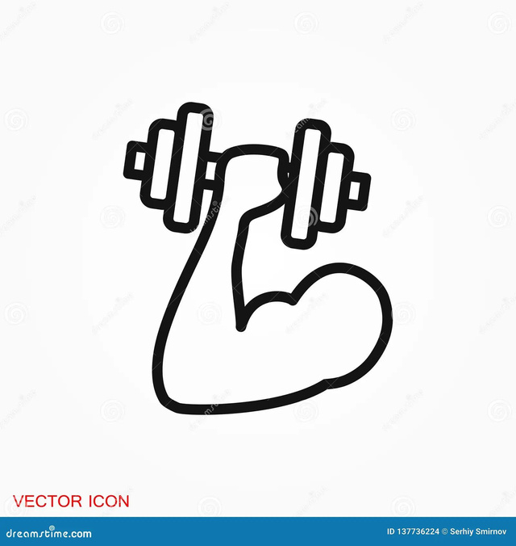
08
Model development
Data preparation
Model
Training and evaluation
Train/test division
Class-weight computation
Definition
Fitting the model
Making predictions

Slide 9

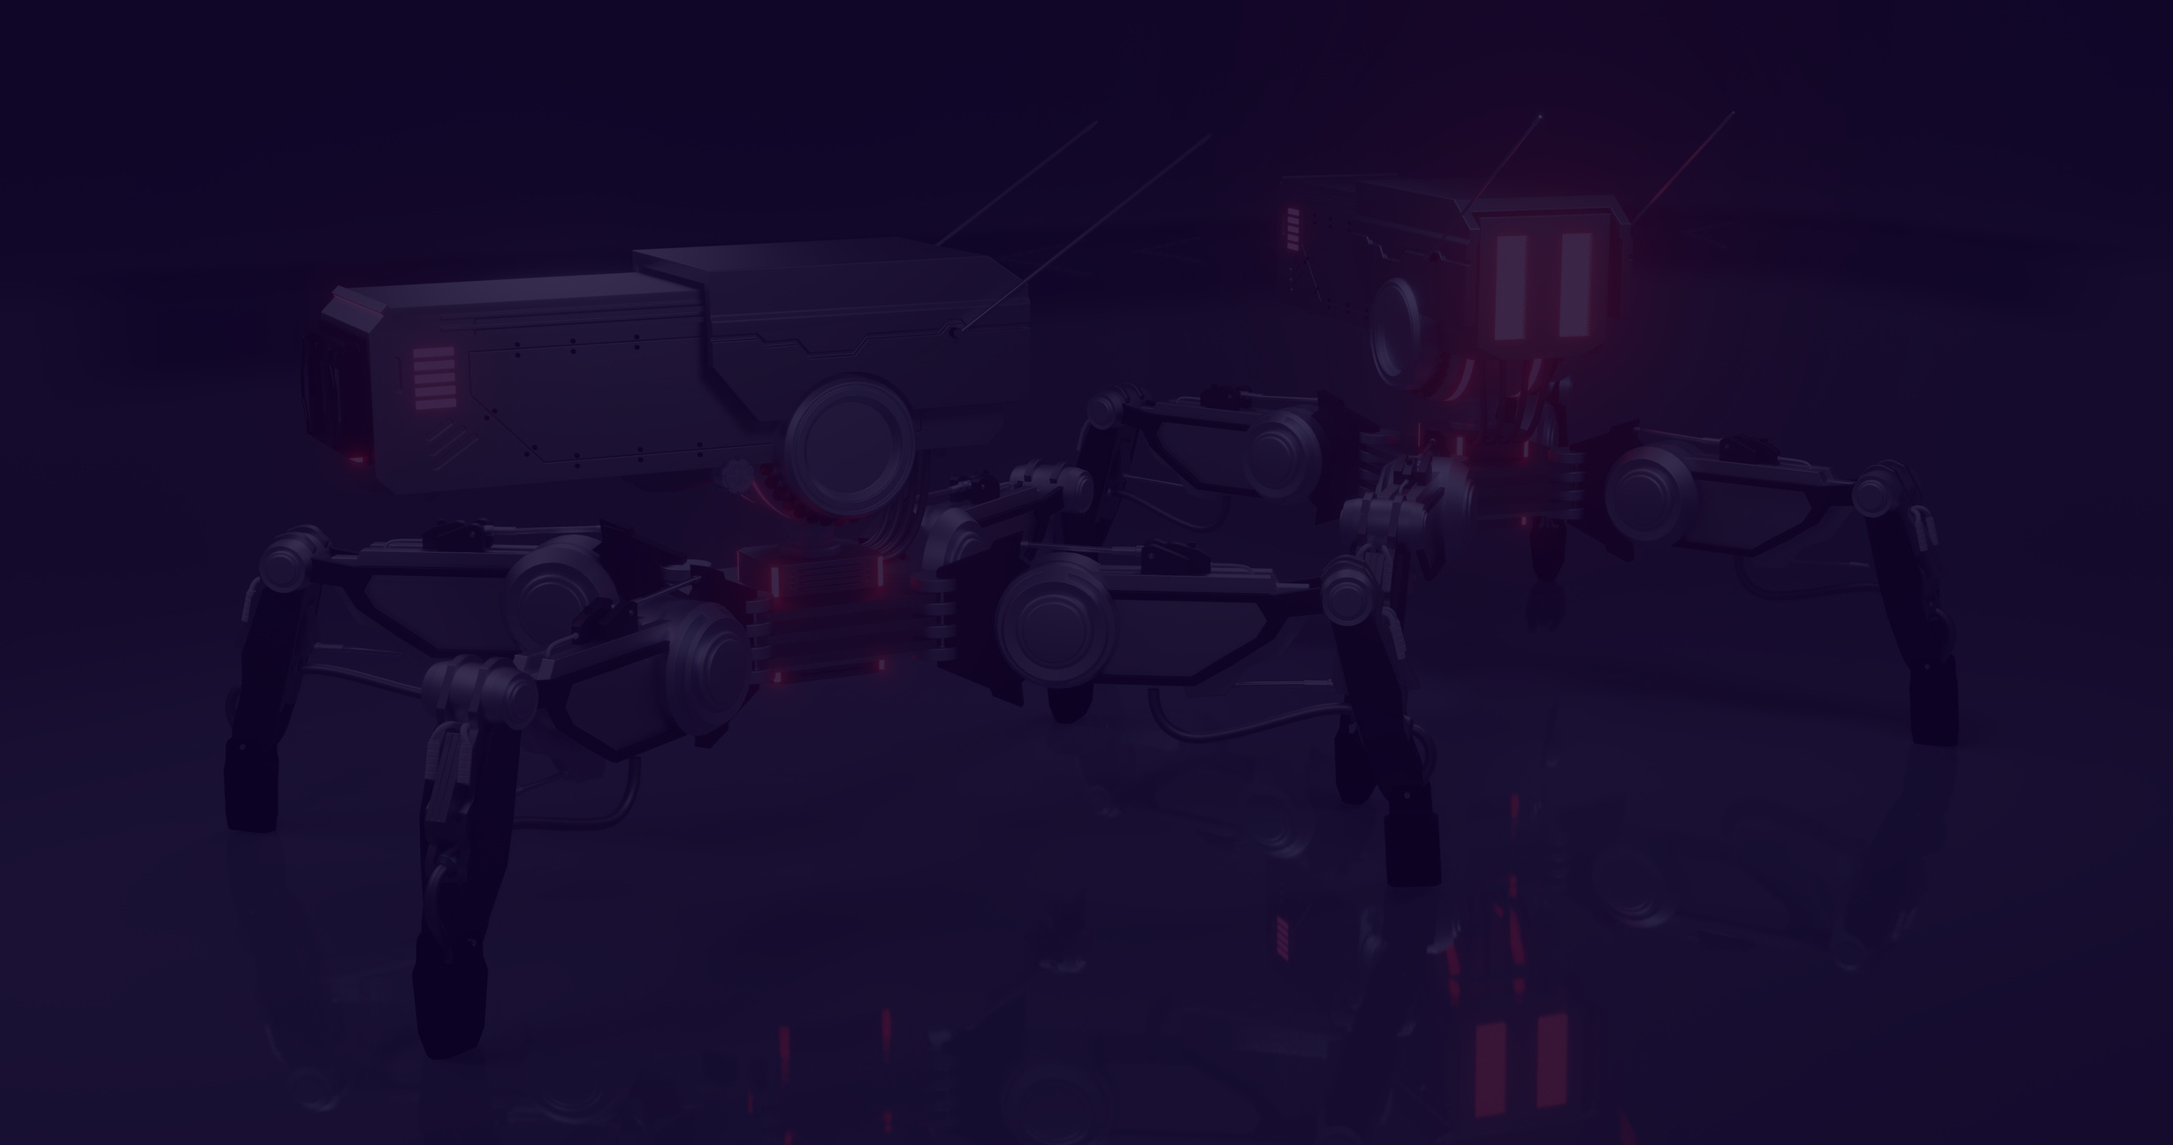
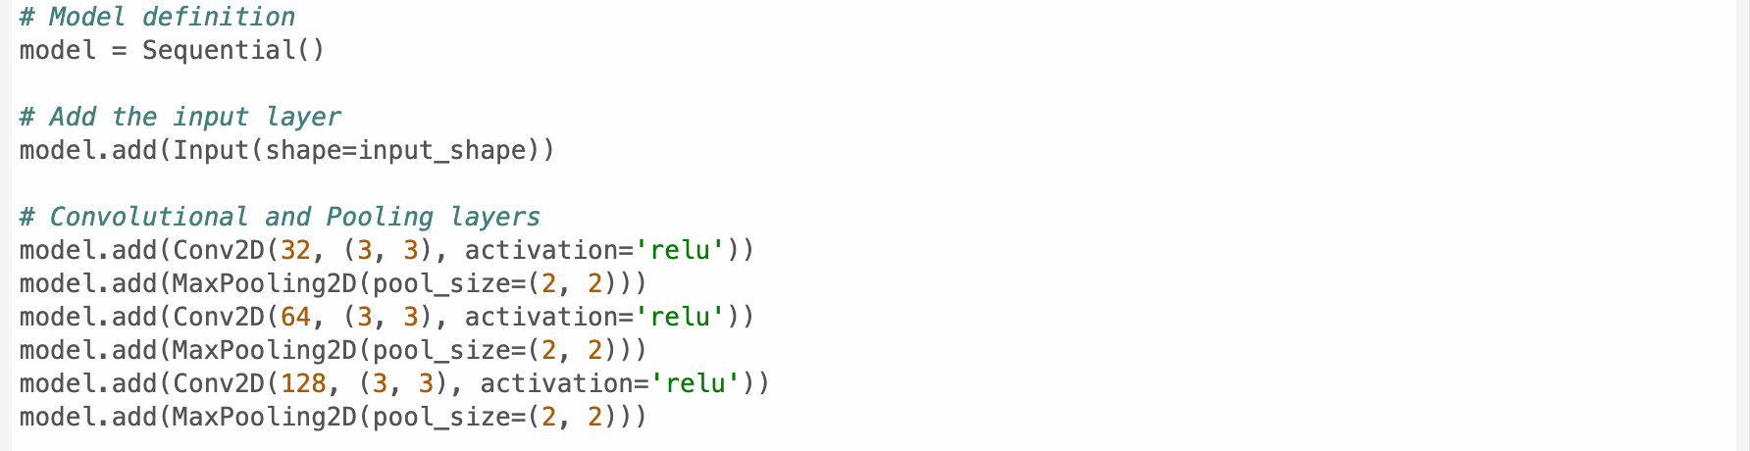
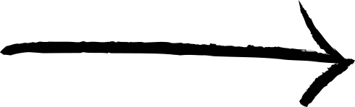
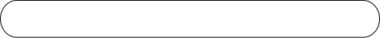
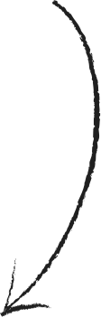

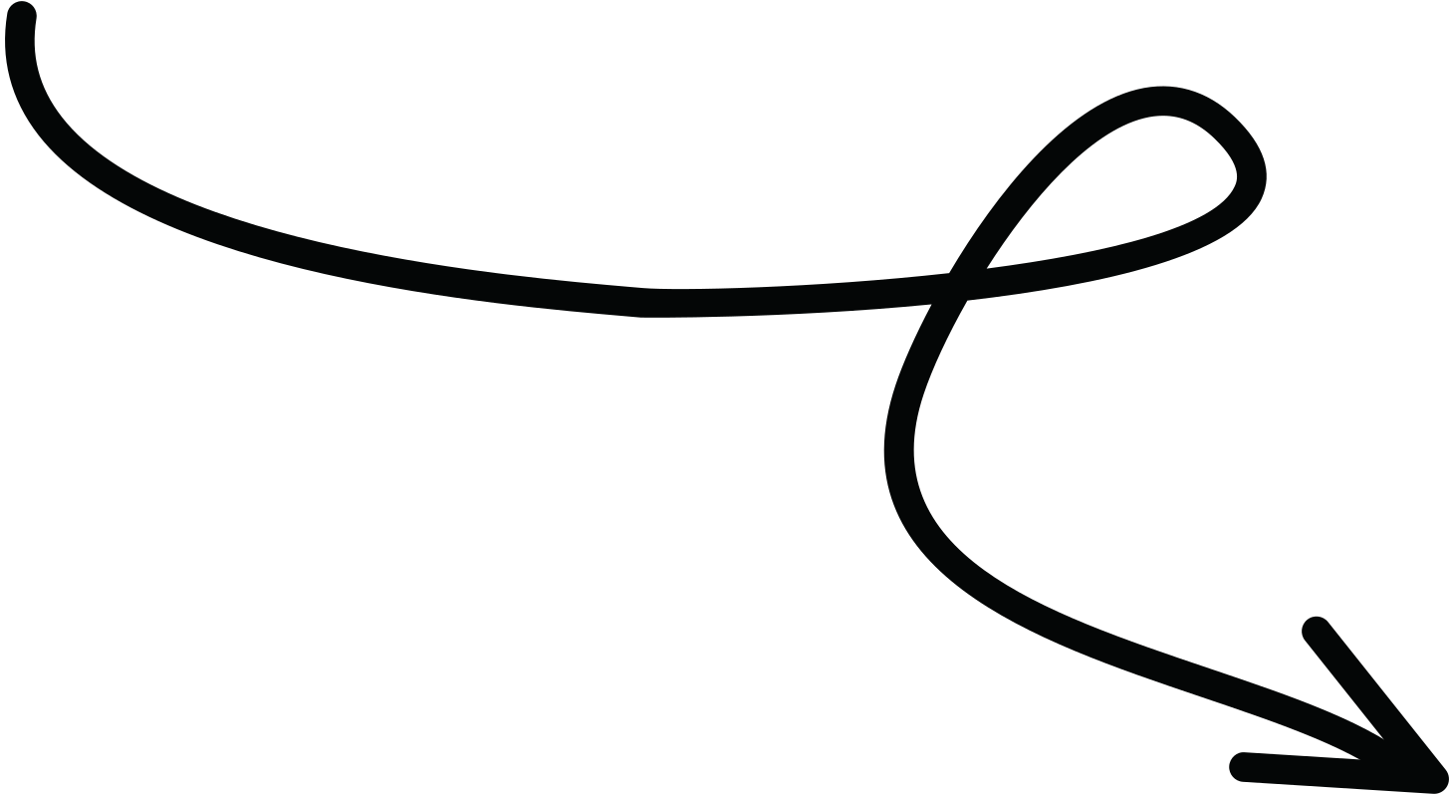
Model definition [1]
The model is created using the Sequential API, which allows you to add layers one after another in a sequential manner.
Input(shape=input_shape): This is the input layer that accepts
images with the specified shape (224x224 and 3 color channels)
It serves as the entry point for data into the model.
Conv2D applies 3x3 filters to extract image features. ReLU removes negative values for faster convergence. MaxPooling2D reduces image resolution to lower model complexity and prevent overfitting.
09

Slide 10
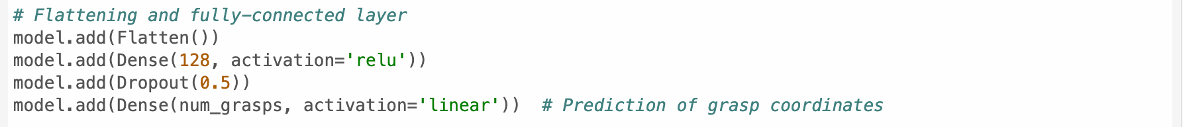
Model definition [2]
Flatten converts 2D data into a 1D vector for dense layers.
Dense(128, activation='relu') combines features with 128 neurons and ReLU activation.
Dropout(0.5) deactivates 50% of neurons during training to prevent overfitting.
Dense(num_grasps, activation='linear') predicts grasp coordinates (x, y) with linear activation for regression.
10

Slide 11
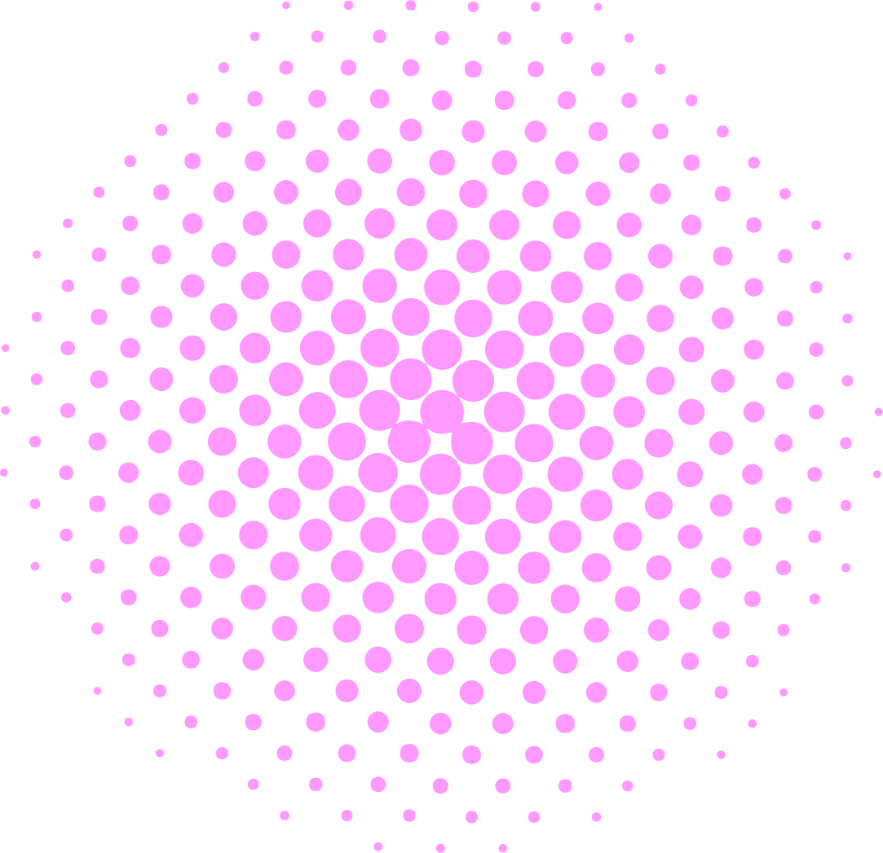


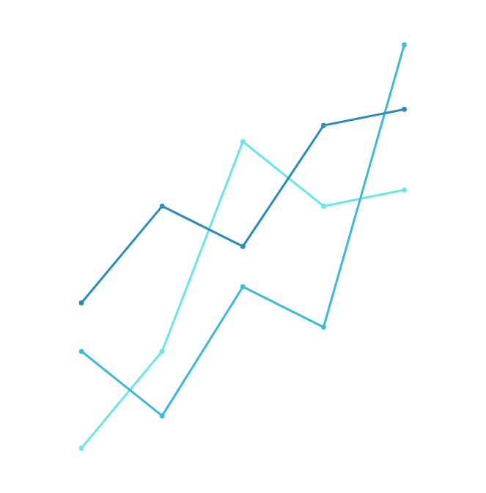
Model compilation
11
optimizer=Adam(): The Adam optimizer is a common choice for gradient descent.
loss='mean_squared_error': The MSE (Mean Squared Error) loss function is used for regression problems, measuring the average squared difference between predicted and actual coordinates.
metrics=['accuracy']: Accuracy is used as a metric to monitor the model's performance during training.

Slide 12

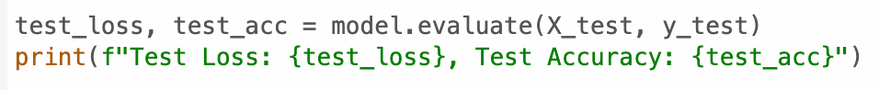

Training and evaluation
12

Slide 13

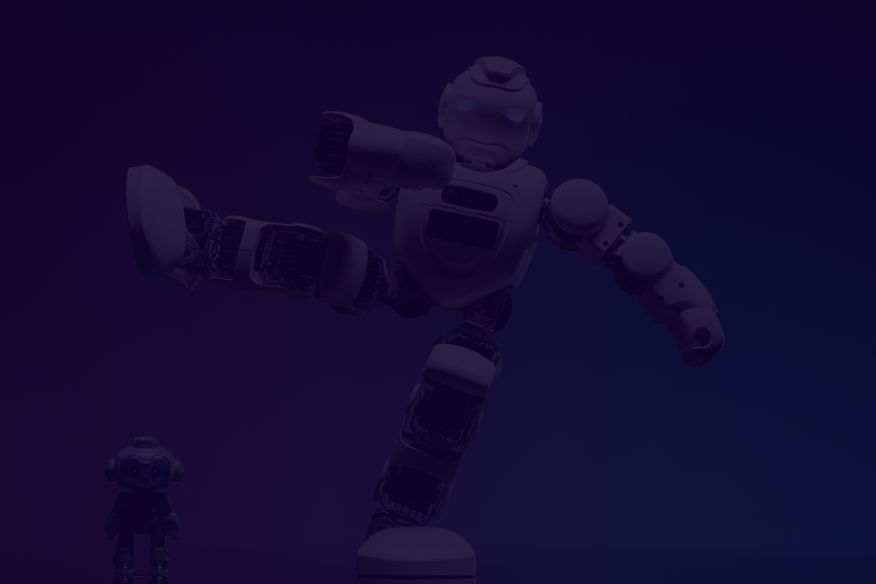
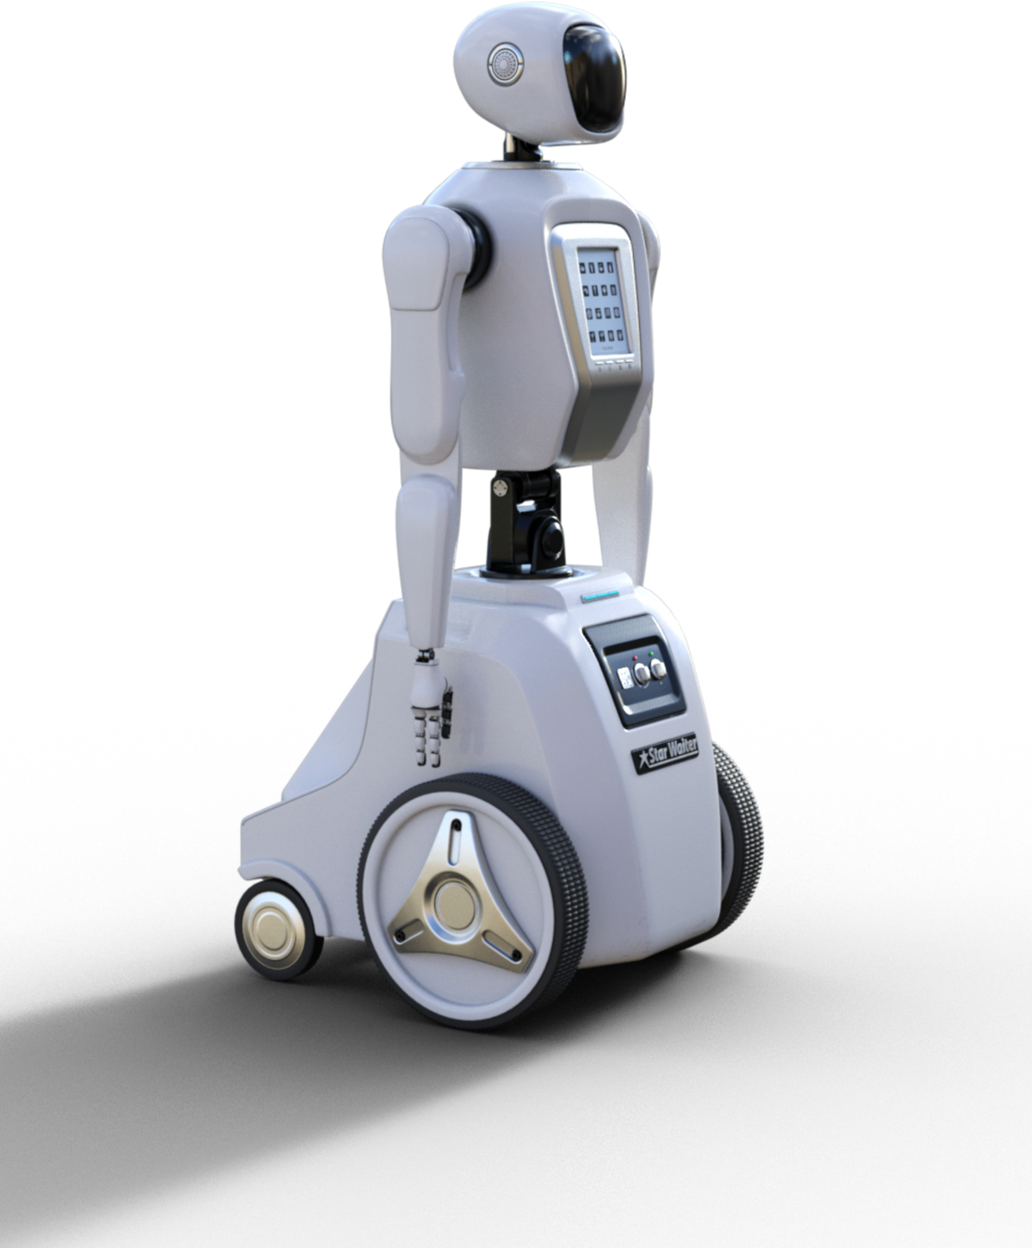
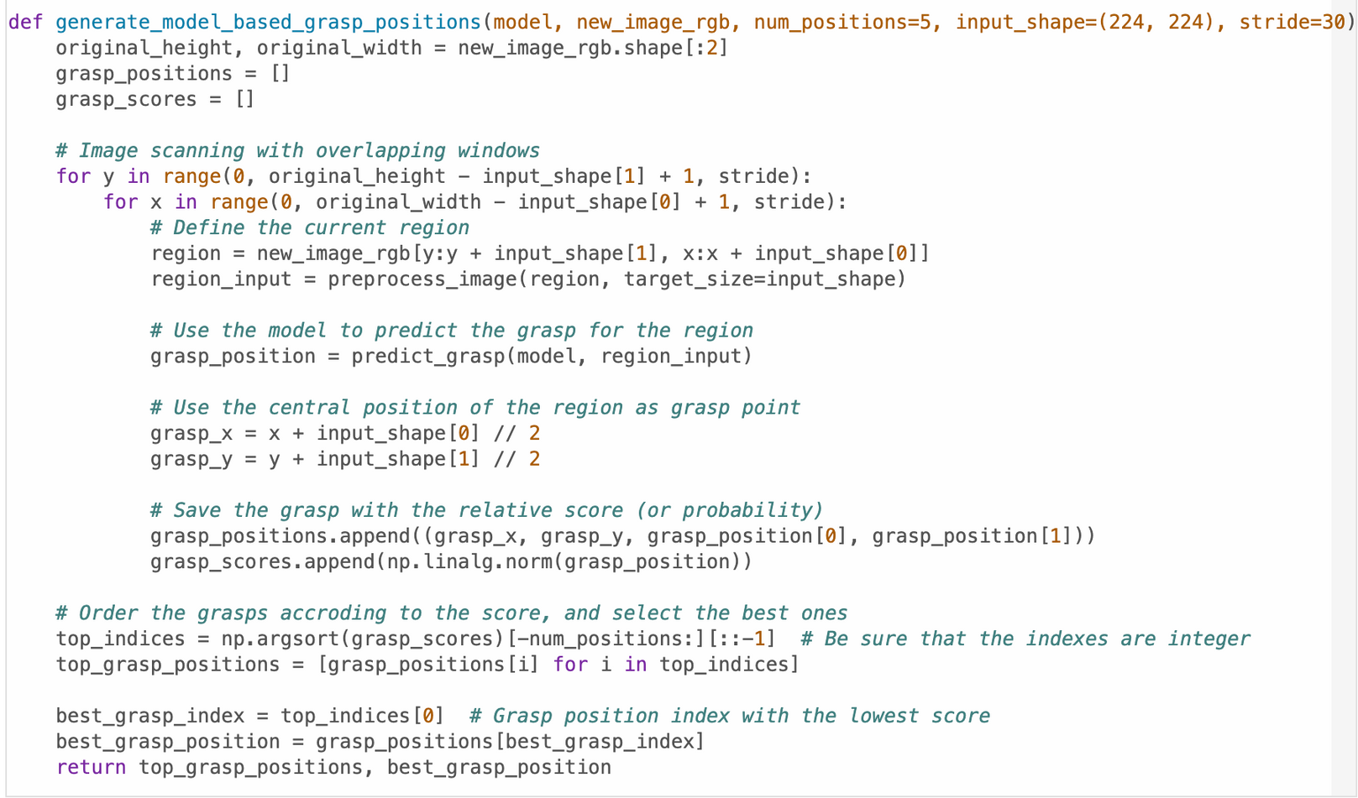
Result and Impact
11

Slide 14
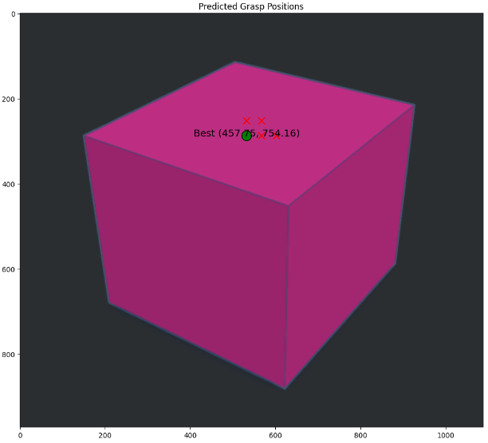
Best grasp position
14

Slide 15


Future Directions
Improvement of Model accuracy: Implement the model in robotic systems for real-time grasping tasks
Extension of different object shapes: Expand the model's capability to determine grasp positions for various shapes and sizes, not just cubes

Slide 16



Thank You!
moscato.2156713@studenti.uniroma1.it
chiessi.2163668@studenti.uniroma1.it

